Slide 1
Development of Critical Experiments to Provide Validation Data for Multiphysics Coupling Methods
Matthew Deric Eklund
July 12, 2016

Slide 2
Progress
Trelis – Experimental Pipe Setup
Meshed the vast majority of the model
Working on resolving meshing issues with minor volumes that require specific attention – no “one size fits all” fix
Trial-and-error fixes
Continuing to work with Iulian Grindeanu
Notes:
2

Slide 3
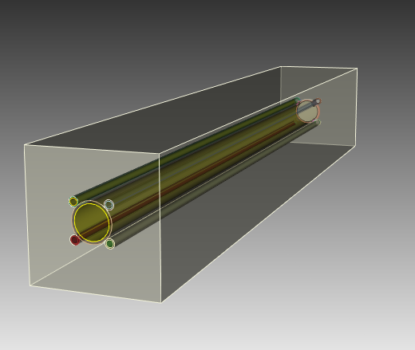
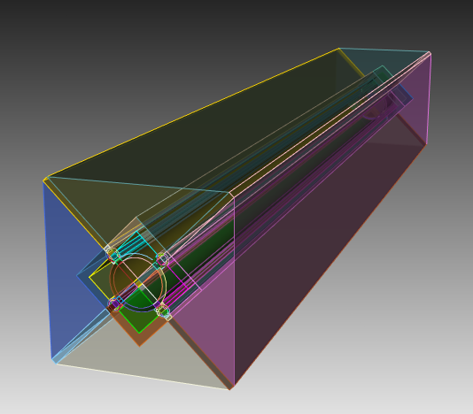
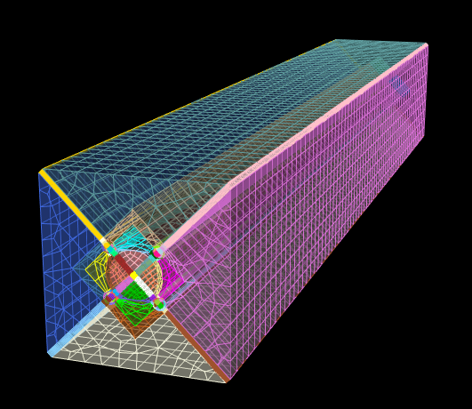
Progress
Figure. Representation of experimental setup in Trelis Pro 16.0. Left: original geometry. Middle: webcuts added. Right: partial mesh.
Notes:
3

Slide 4
Next Steps
Complete and verify mesh of experimental setup is sufficient (check quality)
Import mesh for use in Nek5000 run
Continue debugging Moab installation for PROTEUS install
Run PROTEUS example problems
Notes:
4

Slide 5
References
Nuclear Energy University Programs Project Narrative CFA-15-8101. Development of Critical Experiments to Provide Validation Data for Multiphysics Coupling Methods.
Notes:
5

